Slide 1
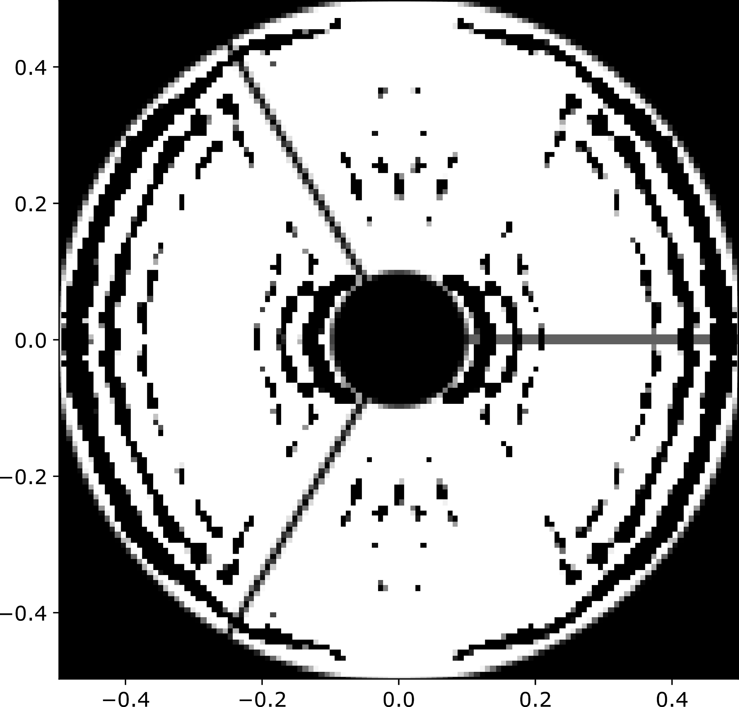
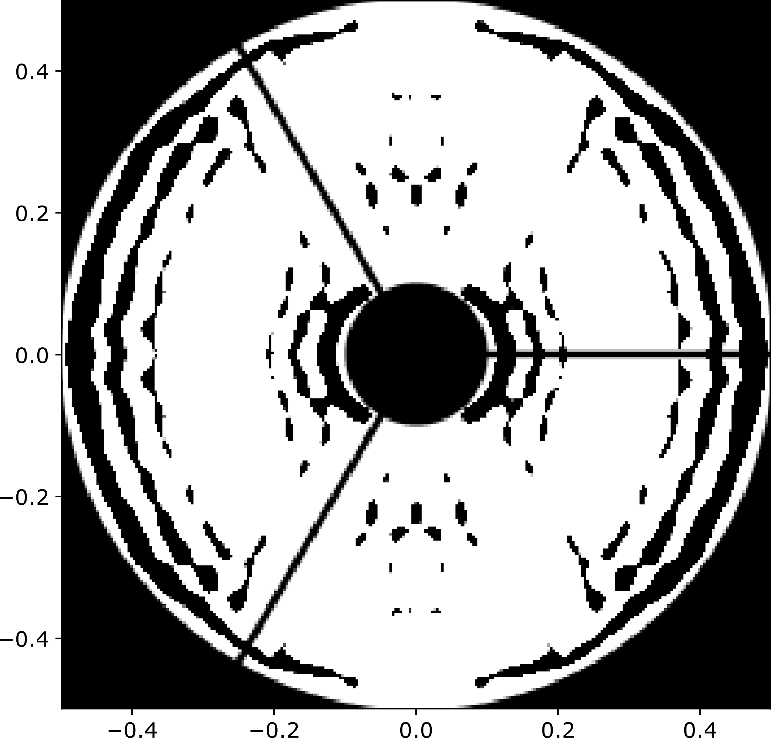

Upscaling lower resolution APLCs
Only optimize pixels on the edges; ignore pixels in the middle of a region
128x128
256x256
512x512

Slide 2
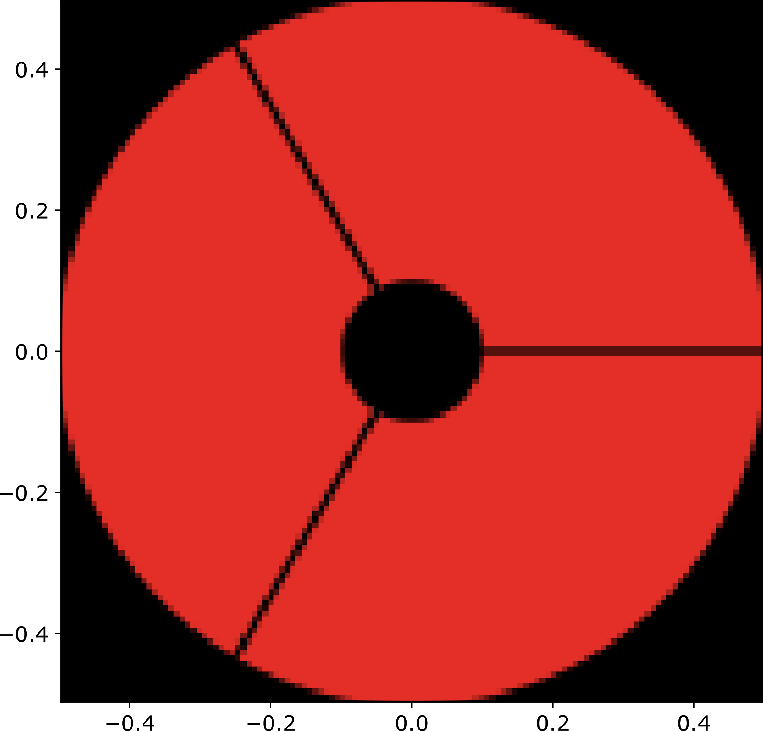
Pixels optimized
128x128
Shaped pupil

Slide 3
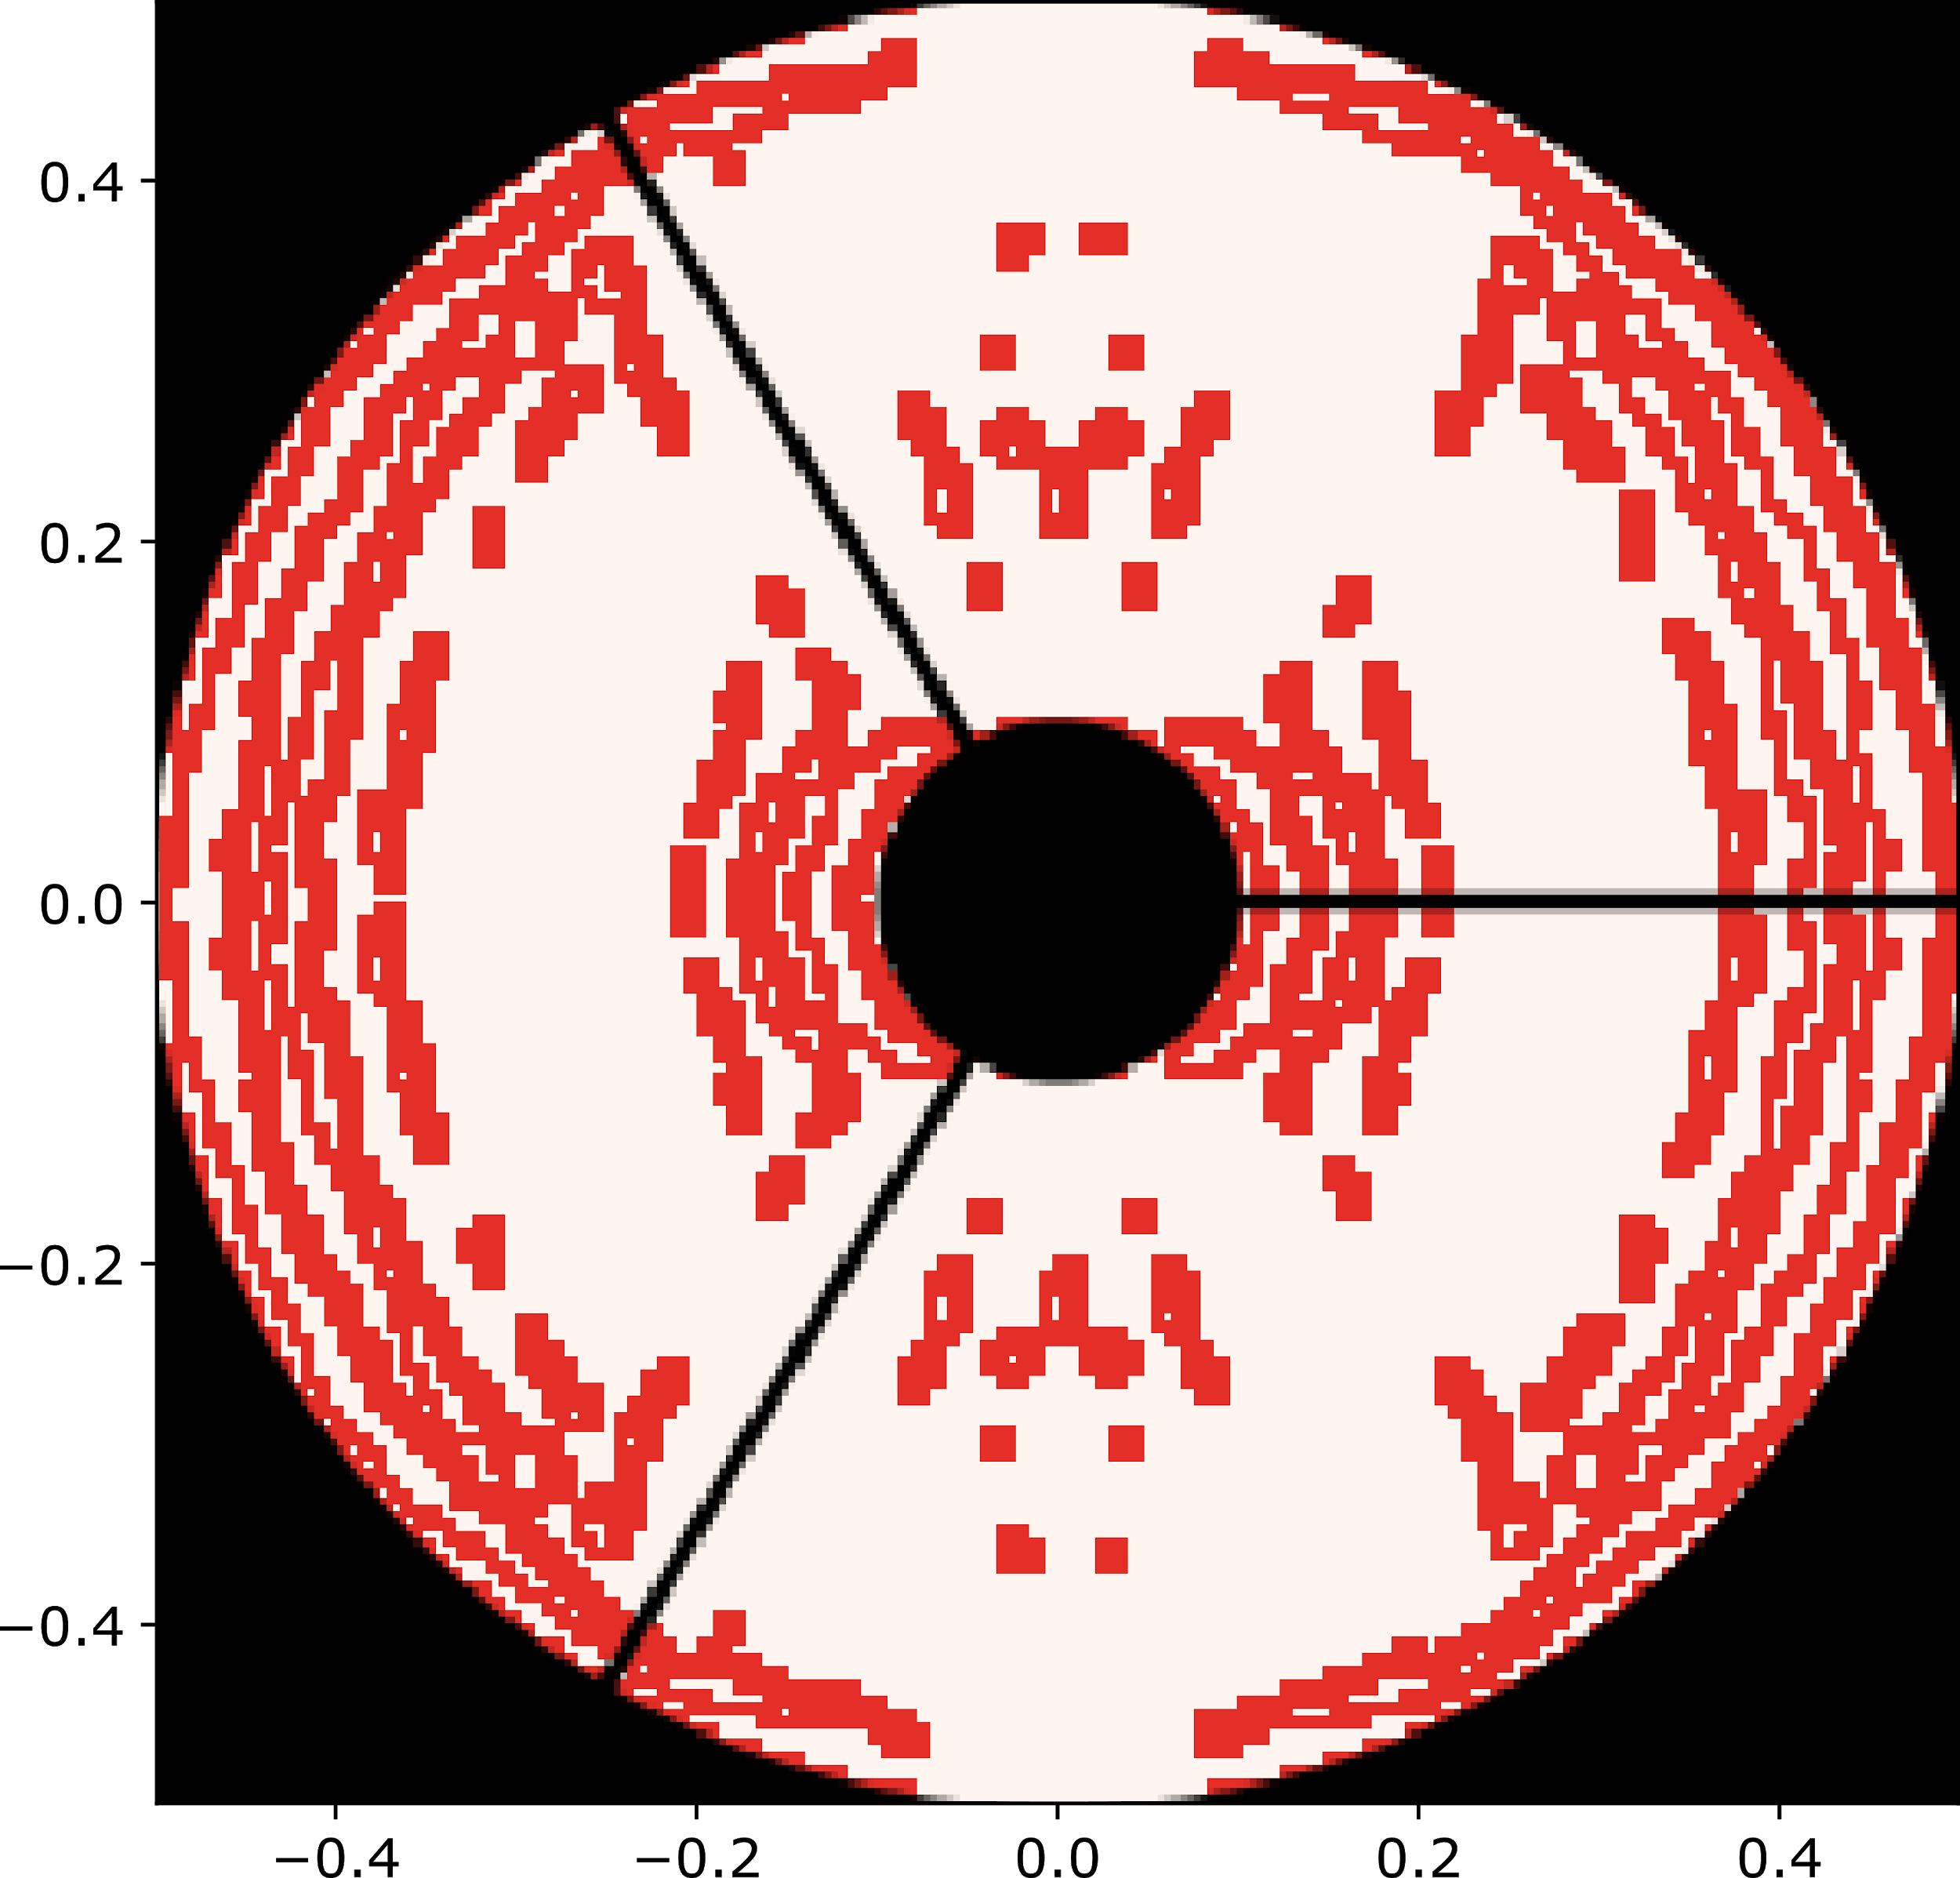
Pixels optimized
128x128
256x256
Shaped pupil

Slide 4
Pixels optimized
128x128
256x256
Shaped pupil

Slide 5
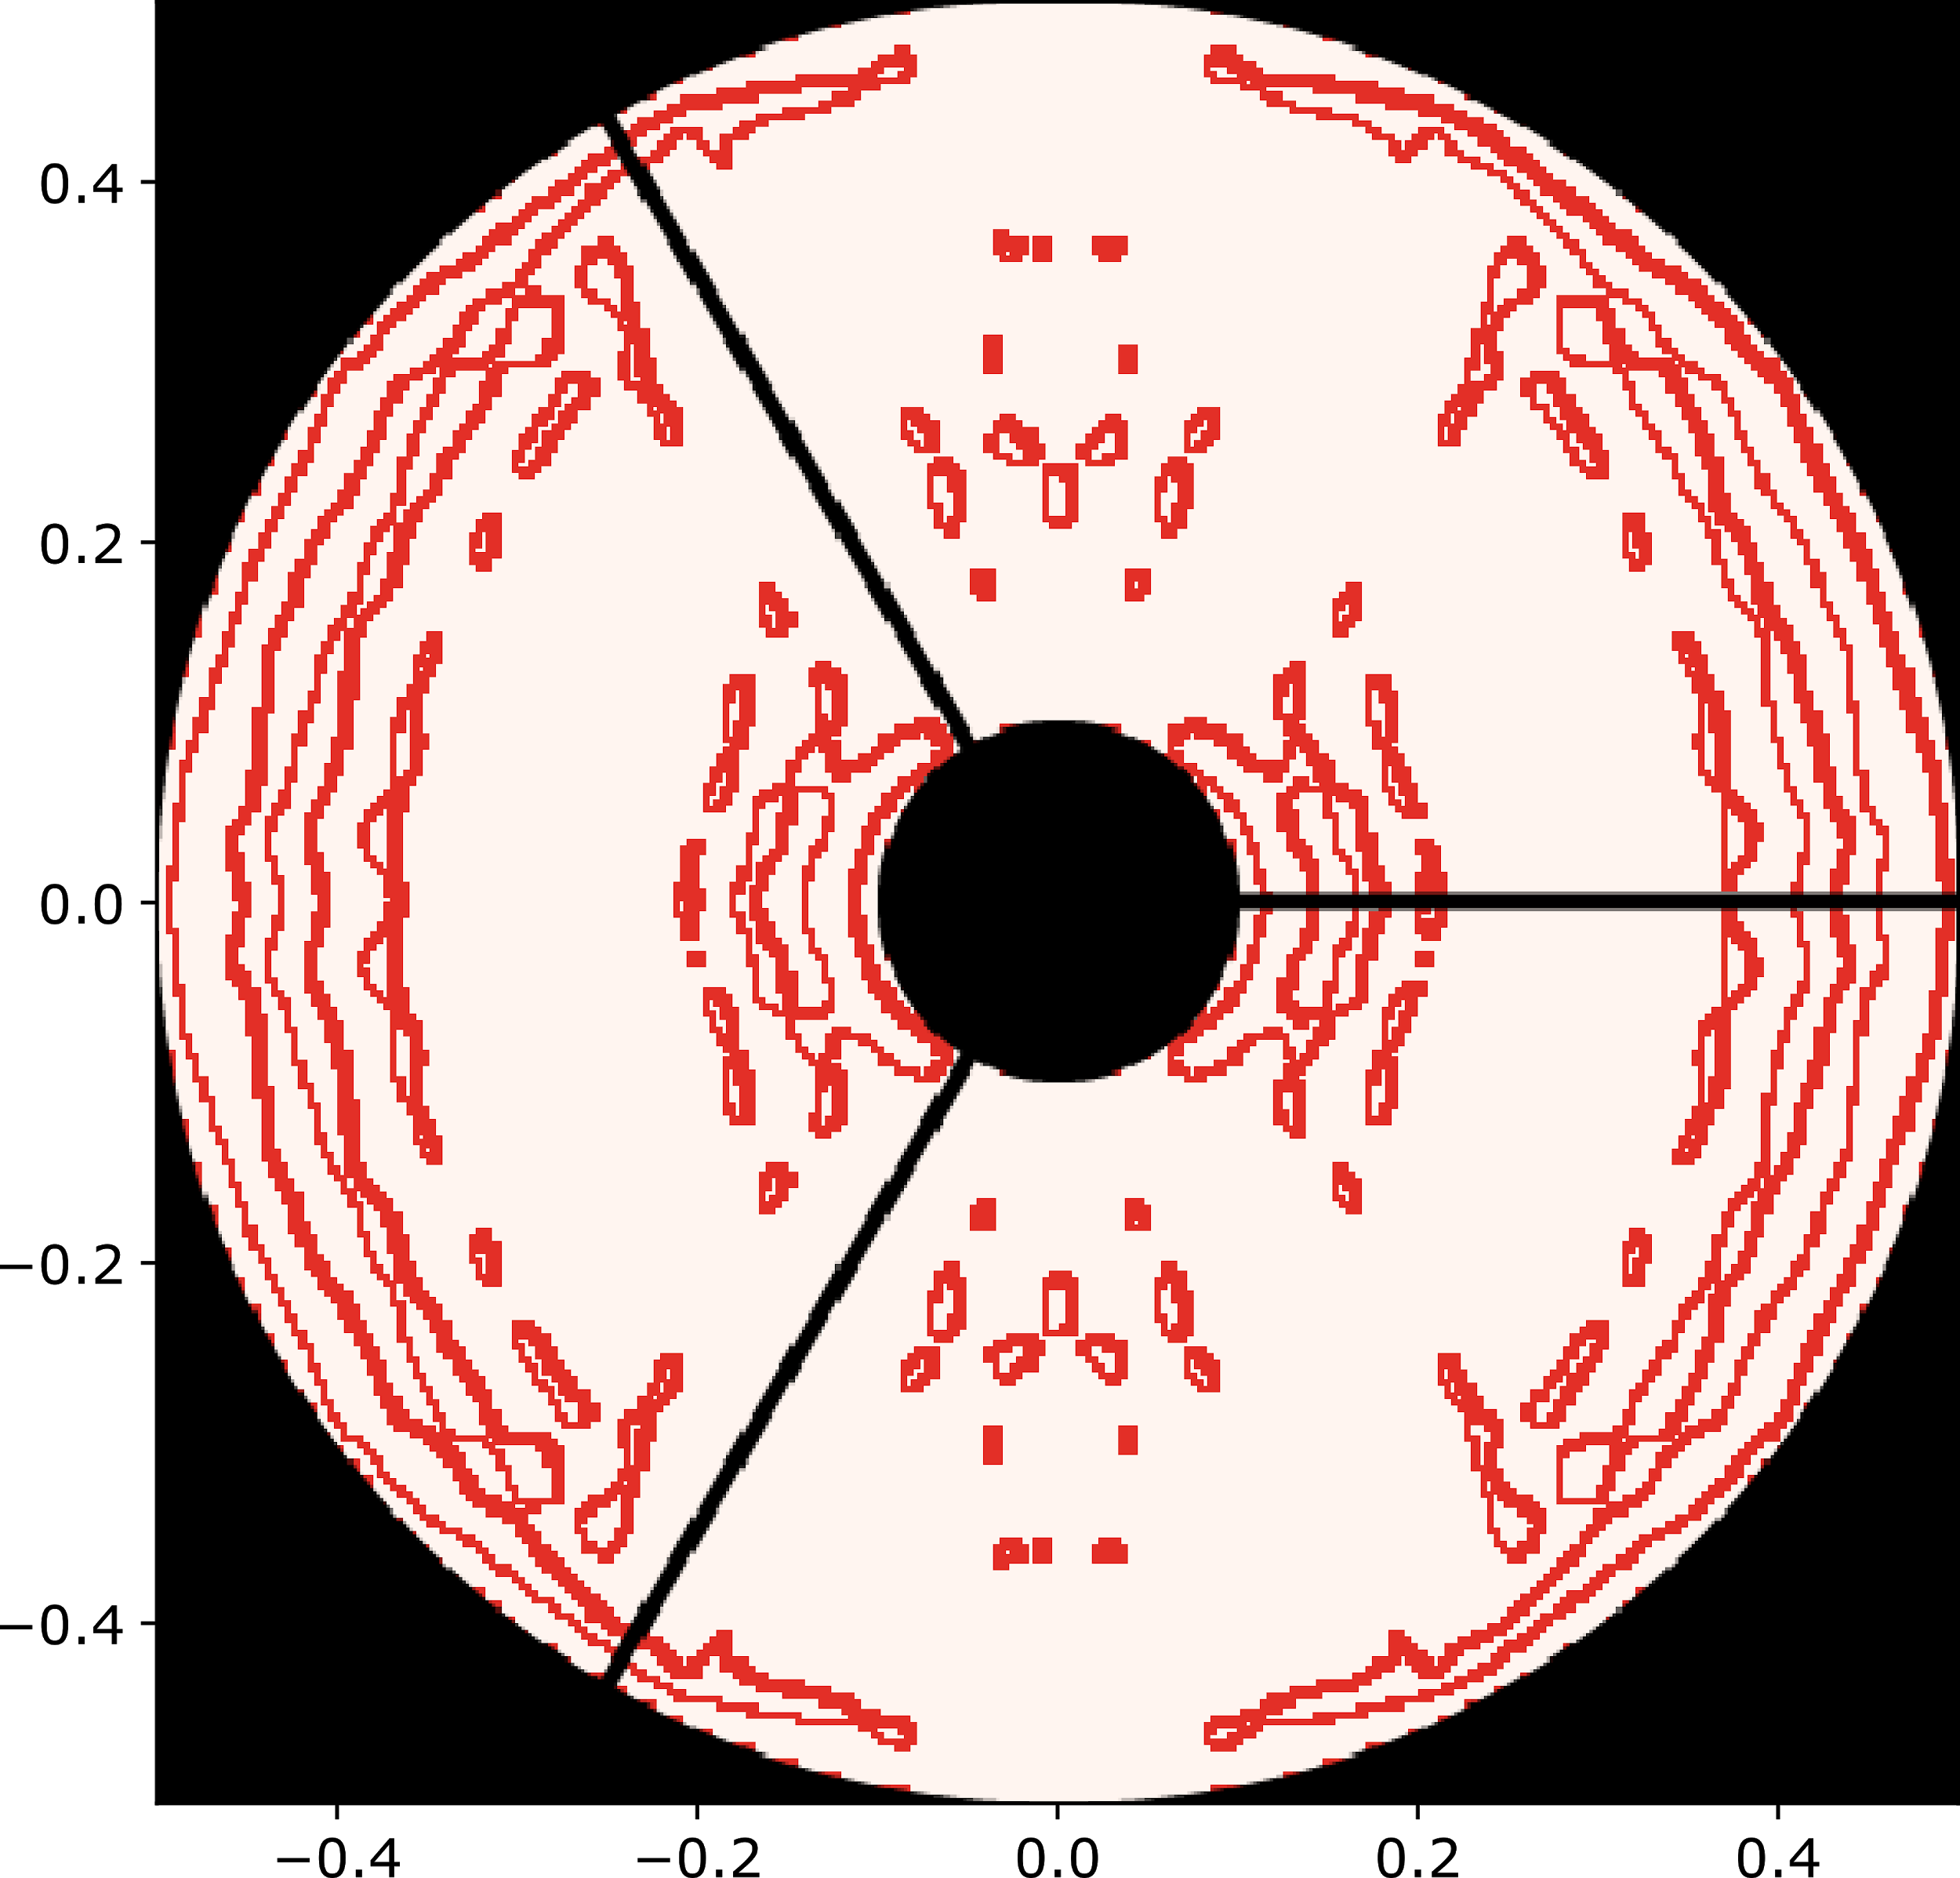
Pixels optimized
128x128
256x256
512x512
Shaped pupil

Slide 6
Reducing in memory usage
(*memory usage not monitored, estimates based on number of variables only)
Resolution | # variables (progressive refinement) | # variables (full resolution) | Reduction memory usage*
128x128 | 12586 | 12586 | 0%
256x256 | 16235 | ~50344 | ~68%
512x512 | 32781 | ~201376 | ~84%

